Slide 1
MobileDeepPill: A Small-Footprint Mobile Deep Learning System for Recognizing Unconstrained Pill Images
MobiSys’17
Department of Electrical and Computer Engineering
Michigan State University
Authors: Xiao Zeng, Kai Cao and Mi Zhang
Presenter: Arjun Prakash
Notes:
Thanks for the introduction.

Slide 2

“National Institute of Health” Pill Image Recognition Competition
What the Competition is about
Work started in 2016.
A mobile based system.
Recognize pills automatically by taking a picture of a pill in real world settings.
Benefits of the Technology
Provide a simple way to recognize mystery pills.
Prevents unnecessary medication errors.
Mostly importantly, save people’s lives in urgent cases.
Notes:
The work started from a NIH Challenge.
In 2016, NIH organized a nationwide pill image recognition competition, calling for a mobile solution that can recognize pills automatically by taking a picture of a pill in real world settings.
The machine intelligence has to be on-device, because the medication an individual takes contains very sensitive and private information.
The invention of such a technology can provide a simple way to recognize mystery pills, prevent unnecessary medication errors, and most importantly, save people’s lives in urgent cases.

Slide 3
“National Institute of Health” Pill Image Recognition Competition
Final Result of this work
First price in this competition
Authors believe that proposed algorithm tackled a critical problem.
Notes:
The work started from a NIH Challenge.
In 2016, NIH organized a nationwide pill image recognition competition, calling for a mobile solution that can recognize pills automatically by taking a picture of a pill in real world settings.
The machine intelligence has to be on-device, because the medication an individual takes contains very sensitive and private information.
The invention of such a technology can provide a simple way to recognize mystery pills, prevent unnecessary medication errors, and most importantly, save people’s lives in urgent cases.

Slide 4
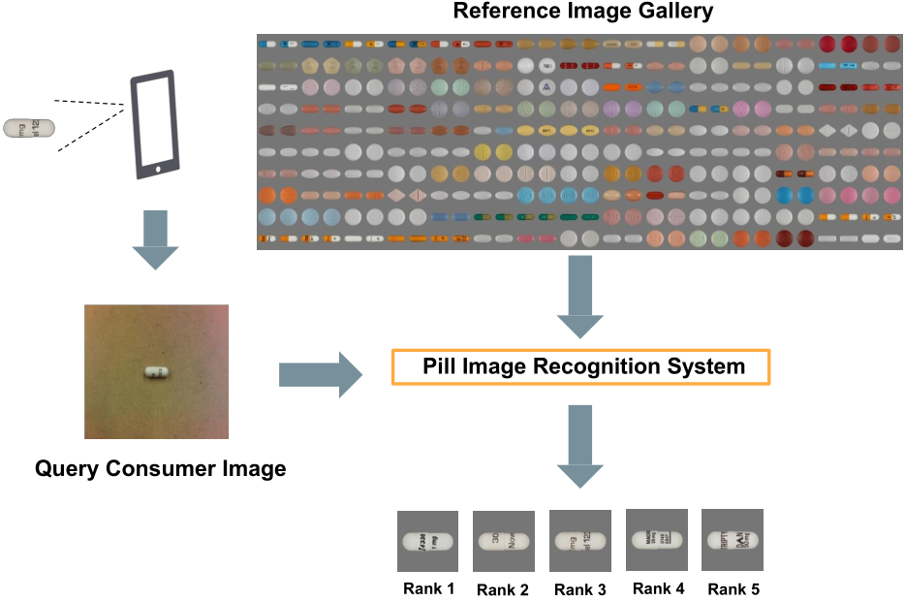
Main Aim of the proposed work
Reference Images
Consumer Image
Notes:
Here is the illustration of the problem.
A user takes a picture of a pill using his or her mobile phone.
The pill image recognition system takes that image as input, compares it against thousands of pills in the NIH database, and returns a list of most similar pills to the user.
The image taken by mobile devices in the unconstrained mobile setting is called consumer image.
The images stored in the NIH database are called reference images, which are taken by higher-resolution camera in well controlled laboratory setting.

Slide 5
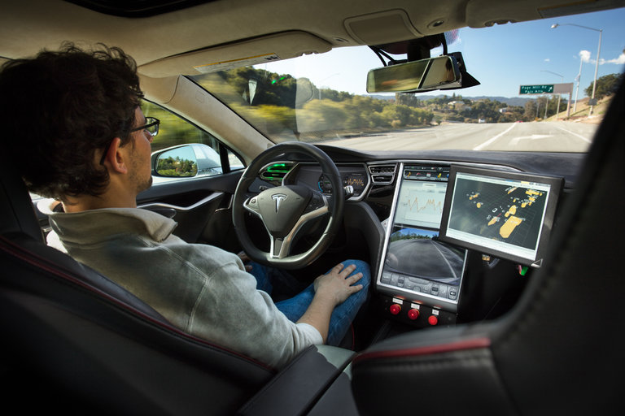
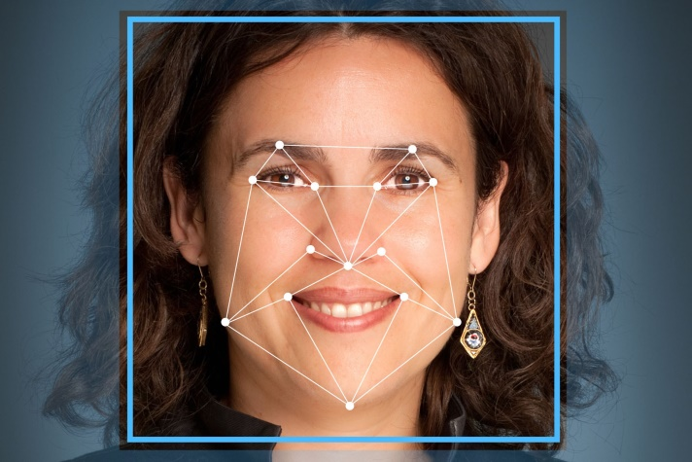
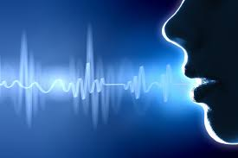
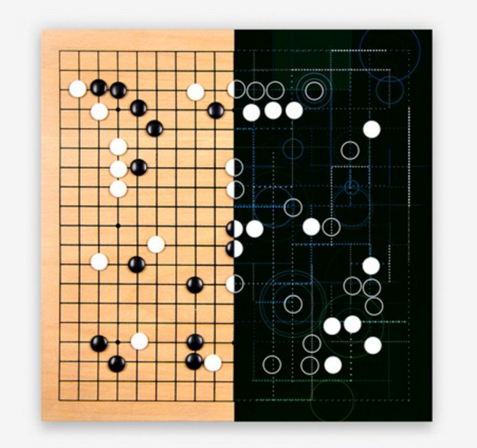
Deep Learning is Changing our Lives Now
Self-Driving
Face Recognition
Speech Recognition
Play Go
Notes:
We all know that deep learning is changing our lives now.
Using deep learning, machines now can drive the car, and outperform humans in many tasks such as face recognition, speech recognition, and even playing Go games.

Slide 6
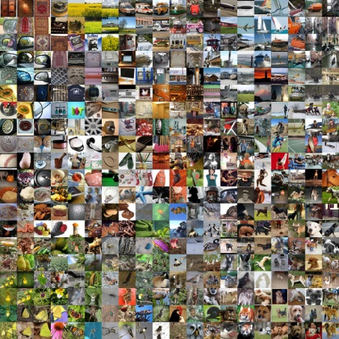


Why Authors chose deep Learning
Impressive capability of handling large scale data.
Easily solves Computer Vision problems such as Face Recognition, Pattern matching.
However, Deep learning cannot be applied everywhere
Large Volume of Data
Large Computing Resources
Notes:
For mobile computing, we are confronting two challenges.
The first one is Data Challenge: in mobile scenarios, data is collected in real world settings. The noise in the real world can easily degrade the data quality.
The second challenge is Resource Challenge: deep learning is computation and memory intensive.
Although today’s smartphones are equipped with amazing computing capabilities, running deep learning models on smartphones is still a very challenging problem.

Slide 7
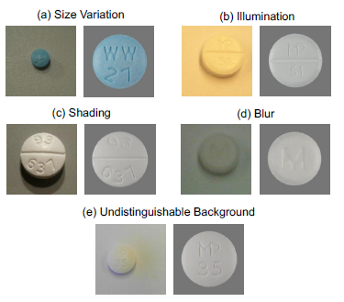
Challenges faced during the implementation
Challenge (1 of 3)
Difference between Consumer pill and the Reference pill: Depends on how people take picture of Consumer pill. Pills totally look different. To overcome this challenge a triplet loss function is generated.
Notes:
For mobile computing, we are confronting two challenges.
The first one is Data Challenge: in mobile scenarios, data is collected in real world settings. The noise in the real world can easily degrade the data quality.
The second challenge is Resource Challenge: deep learning is computation and memory intensive.
Although today’s smartphones are equipped with amazing computing capabilities, running deep learning models on smartphones is still a very challenging problem.

Slide 8
Challenges faced during the implementation
Challenge (2 of 3)
Unreliable pill characteristics: Even though the pill is generally classified on the basis of Color, Shape and Imprint, the characteristics may appear different. For example, white pill turns into yellow. To overcome this challenge, a multi CNN architecture is proposed.
Lack of training data set: To overcome this challenge Data Augmentation is done

Slide 9
Challenges faced during the implementation
Challenge (3 of 3)
Resource Constraints of Mobile devices:
Whole actual processing is done on the phone itself.
To overcome this challenge, a compression technique based on Knowledge distillation is implemented.

Slide 10
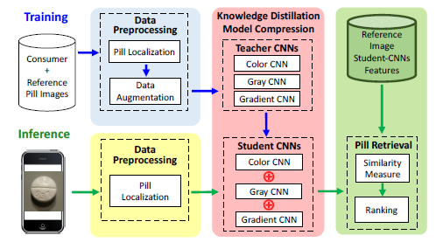
System Overview

Slide 11
Data Preprocessing
Pill Localization
Noise removal
Done for both the images (Reference and Consumer)
Data Augmentation
3-4 steps are performed in a defined order
Gradient detection &
Morphological operations
Extract Background &
Histogram of Gradients

Slide 12
Key Ideas implemented in this work
Triplet loss function: Map Images into a new feature space
How to get correct reference image for corresponding Consumer input image: A model of Multiple Convolution Neural Network has been implemented.
Compression Technique using Knowledge distillation: How to run such a big system keeping in mind the resource constrains.

Slide 13
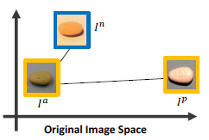
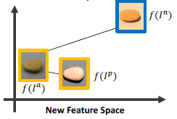

First Key Idea: Map Images into a New Feature Space
Triplet loss
Objective of this step:
Notes:
The first key idea is to map pill images into a new feature space.
Assume we have 3 images in the original image space: an anchor image, a positive image, and a negative image.
The anchor image and the positive image are from the same pill, and the negative image is from a different pill.
Due to real-world noise, the negative image is closer to the anchor image compared to the positive image. As a result, the negative image is misclassified to be the same pill as the anchor image.
What we want, is to create a new feature space, such that in this new feature space, the anchor image and positive image are closer while the anchor and negative images are distant. As a result, the anchor image is correctly classified.

Slide 14
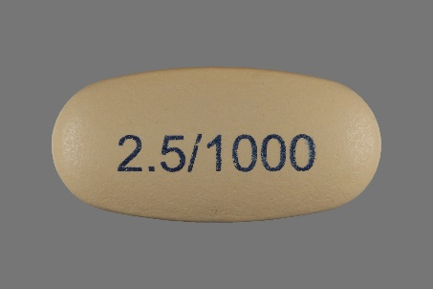
Deep ConvNet Learns Features Automatically
ConvNet
227
55
27
13
13
6
227
55
13
13
6
Self-Learned
Features
27
L2
384
256
128
128
96
256
384
Conv 1
Conv 2
Conv 3
Conv 4
Conv 5
1024
FC1
FC2
Pool 1
Pool 2
Pool 5
Notes:
We use a deep convolutional neural network, or ConvNet in short, to learn the features automatically and create the desired new feature space.

Slide 15
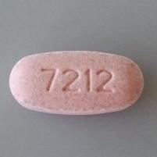
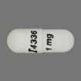
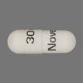
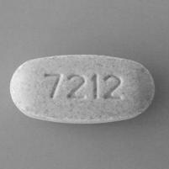
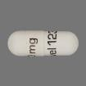
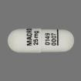
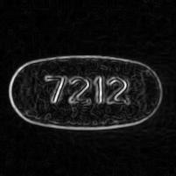
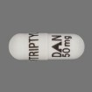
Second Key Idea: Use Multiple ConvNets that Provide Complementary Info
Color
Reference Image Gallery
Color ConvNet
Color
Rank 1
Gray
Shape
Rank 2
Gray ConvNet
Pill Retrieval
Fusion
Rank 3
Gradient
Imprints
Gradient ConvNet
Rank 4
Rank 5
Gray and Gradient images of the original color pill images are used to train the CNN.
15
Notes:
Gray and gradient images not only alleviate the dependency on color, it also attain enhanced shape and imprint information to train the model in a more efficient manner.

Slide 16
Second Key Idea: Use Multiple ConvNets that Provide Complementary Info
(continued)
Color
Color ConvNet
All the CNNs have same architecture except the first convolution layer.
Color CNN has 3 inputs (RGB)
Gray and gradient CNN’s not only remove pressure from the color CNN, it also helps to train the model in a more efficient manner.
Color
Gray
Gray ConvNet
Shape
Gradient
Gradient ConvNet
Imprints
Notes:
It turns out that we can make our system more resilient to real world noises by combining multiple convets that provide complementary information of the pill.
So we use 3 convnets, the first focusing on color information, the 2nd focusing on shape information, and the 3rd focusing on imprint information. And then we combine these 3 convnets together.
This idea works really well because even if the color of the pill is changed, we can still count on the shape and imprints information extracted by the other 2 convnets to retrieve the correct pill.

Slide 17

Pill Retrieval
Similarity scores are summed up after the individual output of all the 3 CNN’s.

Slide 18
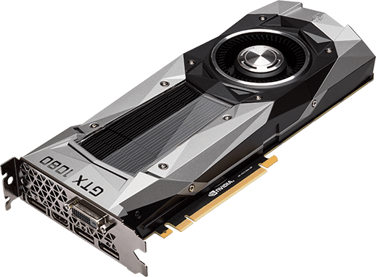
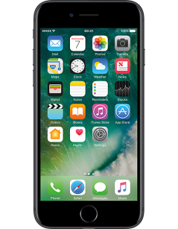


Resource Challenge: Deep Learning is Computation and Memory Intensive
ConvNet
Single ConvNet
#Params
#FLOPS
131K
FC2 128
0.1M
Over 1b FLOPS for one inference.
54 MB just for model storage.
9940K
FC1 1024
9.4M
Multi-ConvNets (3X)
885K
Conv5 3x3, s1, 256
150M
Over 3.2b FLOPS for one inference.
160 MB just for model storage.
1330K
Conv4 3x3, s1, 384
224M
885K
Conv3 3x3, s1, 384
150M
615K
Conv2 5x5, s1, 256
448M
35K
Conv1 11x11, s4, 96
112M
13.32M in total
1.093b in total
Notes:
It seems like everything goes well and we are done.
However, deep learning has a problem: it is computation and memory intensive.
A single ConvNet used in our system requires over 1b FLOPs just for one single inference. And it requires 54 MB just for model storage.
Remember we need 3 such convnets to deliver the best pill recognition performance. So the number is tripled.
Usually these models are run on GPU. How can we run it on resource-limited mobile devices?

Slide 19
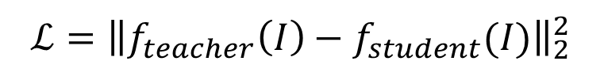
Third key Idea: Teacher-Student Learning for Model Compression
Student Network
Knowledge
Distillation
$$ℒ={\left\|f_{teacher}\left(I\right)−f_{student}(I)\right\|}_{2}^{2}$$
Teacher Network
The training of the student CNN is done with the help of the knowledge extracted from the teacher CNN.
Notes:
In this work, we propose a teacher-student learning framework to compress the large network into a small network, such that the small network can be fit into mobile devices.
In this framework, the teacher network is the large network that needs to be compressed. The student network is the desired small network.
The central idea of teacher-student learning is to enforce the student network to imitate the outputs of the teacher network.
This is achieved by using this loss function, which just means the student must follow whatever the teacher says.
This training process is called Knowledge Distillation, which can be viewed as teacher transferring knowledge to the student.

Slide 20
Tradeoff in the Deep Convolutional Neural Network Architecture
A deep neural network consists of multiple layers
Volume of Each Layer
55
27
13
13
6
55
27
13
13
96
256
256
384
256
Depth of the Network
Rule of Thumb for Tradeoff:
Make the Network Deeper & Shrink the Volume at Each Layer.
Notes:
A deep neural network consists of a number of layers.
The total number of layers is called the depth of the network.
The deeper the network is, the better the learning capability it has.
For each layer, the deep neural network arranges its neurons in 3D volume.
The rule of thumb for tradeoff is to make the network deeper to maintain its learning capability, and shrink the volume at each layer to reduce the model size.
In other words, we will make the network taller but thinner.

Slide 21
Student Network Design Steps
Teacher
Student
conv1
conv1
Layer replacement: Split one layer into two smaller sub layers to increase the depth and shrink the volume at each of the two sub layers.
conv2
conv2a
D
conv2b
D
conv3
E
conv3a
C
conv4
E
conv3b
C
conv5
E
conv4a
C
E
conv4b
C
conv2
conv2a
conv2b
E
conv5
A
conv6
B
Notes:
By following the rule of thumb, we use the teacher network as the starting point, and incrementally build the student network step by step.
Layer replacement scheme.
Each color and letter represents a step in the design process.
For example, at step D, we split conv2 layer into two smaller sub layers conv2a and conv2b to increase the depth, and shrink the total volume of the overall network.
By following those steps, the student network becomes taller and thinner.

Slide 22

Evaluation
Dataset:
2000 Reference images of 1000 pills.
5000 Consumer images of 1000 pills.
2 Evaluation Metrics for evaluation:
Mean Average Precision (MAP):
Top-K Accuracy: In practice, users are only interested in the Top K pill candidates retrieved by the system.

Slide 23
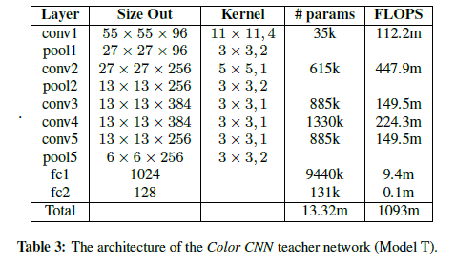
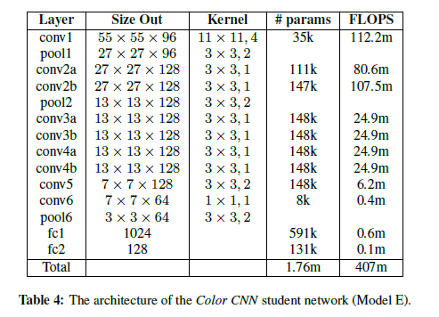
Results of Model Compression
#Params: 6.6X
#FLOPS: 1.7X
Notes:
This table shows the results of model compression.
The generated student network has only 1.76M parameters and 407M FLOPS.
Compared to the original teacher network, the corresponding compression ratio is 6.6 for the number of parameters; and 1.7 for FLOPS.

Slide 24
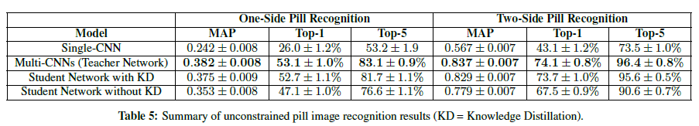
Multi-ConvNets outperforms Single-ConvNet
27%
31%
29%
0.27
22%
0.14
Single-CNN compared with Multi-CNNs (Teacher Network)
Multi-CNNs (Teacher Network) compared with Student Network with KD
Student Network with KD compared with Student Network without KD
Notes:
Here is the performance of the multi-convnets.
As we can see, the multi-convnets outperform single-convet across all 3 metrics.
Given the consumer images are taken in noisy unconstrained conditions, achieving over 96% top-5 accuracy is a very impressive result.
The results reported so far are achieved by the teacher network. How about the performance of the student network?

Slide 25
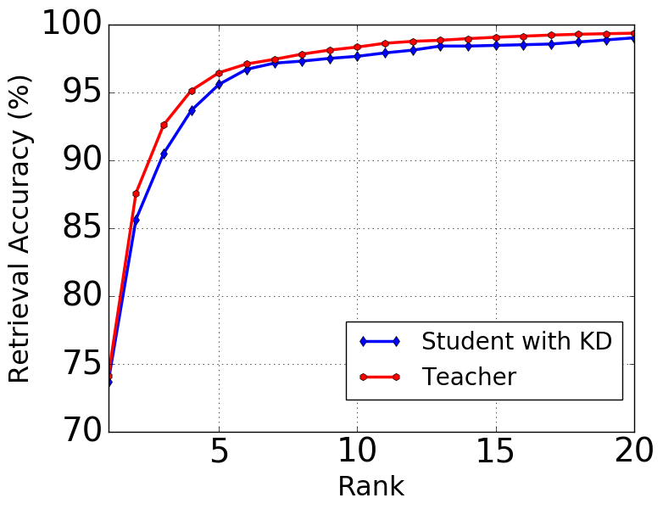
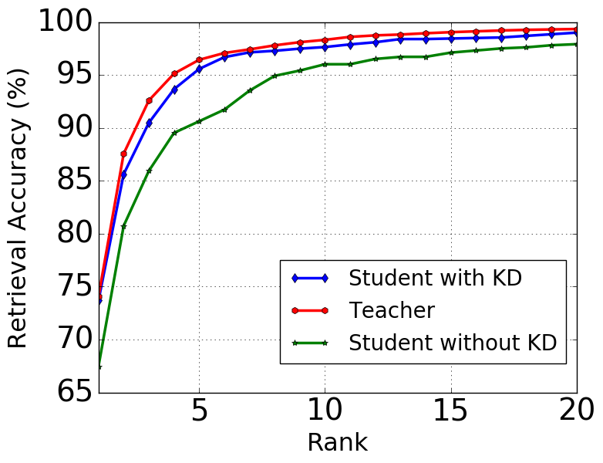
Student Network with Knowledge Distillation (KD) is Impressive!
Teacher: 96.4%
Student with KD: 95.6%
Student with KD: 95.6%
Student without KD: 90.6%
Top-K Accuracy
Top-K Accuracy
2 side pill recognition pill scheme
Notes:
Here is the performance of the teacher network and the student network.
Even the student network is much smaller in size, with the knowledge passed from the teacher, it can achieve almost equivalent recognition performance.
For example, for top-5 accuracy, the student network achieves 95.6%, which is only 0.8% less than the teacher network.
How about letting the student network learn by itself without knowledge passed from the teacher?
As we can see, the student network is no longer capable of achieving the same recognition performance as its teacher.

Slide 26
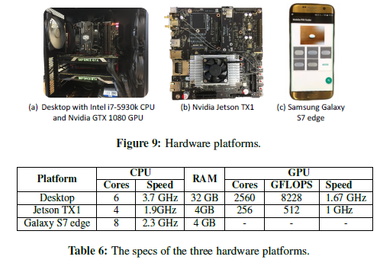
Platforms for implementation and testing

Slide 27
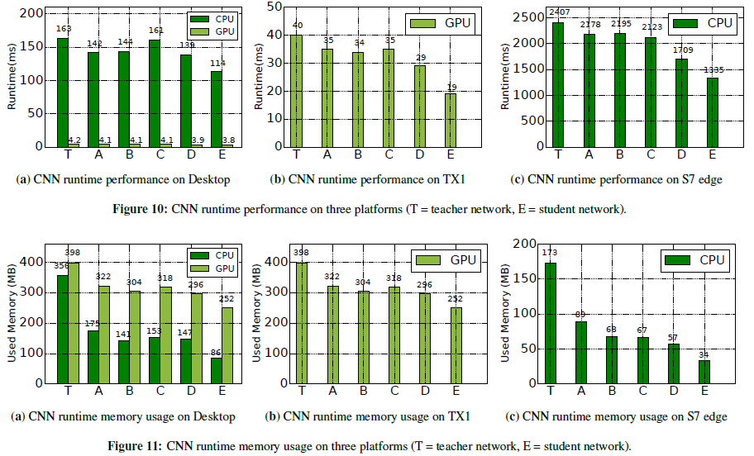
Runtime Performance and Memory Usage

Slide 28
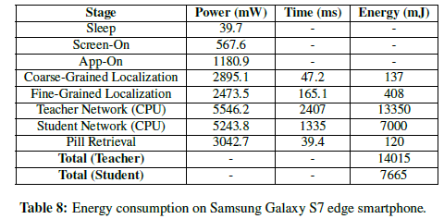
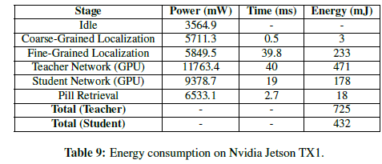
Power and Energy Consumption Results
-47.6%
-62.2%

Slide 29
Conclusions
First mobile deep learning system that achieves state-of-the-art performance on recognizing unconstrained pill images has been introduced.
A deep learning-based approach to address the data challenge in mobile computing has been implemented.
Finally, the resource challenge in mobile computing using a teacher-student framework has been addressed. It compresses large deep neural networks into small networks without degrading the recognition performance.

Slide 30
Critique
A mandatory wrapper around every pill.
Runtime performance for Galaxy S7 – Refer Figure 10 (slide 27)
Ranking is not the best idea– Refer 8 (slide 25)
No comparison with any other existing systems
Reason for not using cloud – Privacy of user!!!
30

Slide 31
Thank You

